Slide 1

POST MORTEM CHANGES

Slide 2
Forensic Taphonomy
It is the interdisciplinary study and interpretation of postmortem processes of human remains in the dispositional context i.e. the history of a body following death

Slide 3

POST MORTEM CHANGES
IMMEDIATE SIGN
EARLY SIGN
LATE SIGN

Slide 4
IMMEDIATE SIGNS:
Insensibility and loss of movements
– with voluntary power.
Cessation (stoppage) of respiration
Cessation (stoppage) of circulation

Slide 5
EARLY SIGNS OF DEATH:
Lossof elasticity of skin
Changes in the eyes
Changes of muscles
Cooling of body (Algor mortis)
Post mortem lividity (Livor mortis)
Rigor mortis

Slide 6
LATE SIGNS:
Decomposition
Adipocere formation
Mummification

Slide 7
Insensibility & Loss of movement :
Earliest sign
prolonged fainting attack, vagal inhibitory phenomenon,
epilepsy, trance, electrocution
Cessation of Respiration :
Complete stoppage of respiration for more than 4-5 minutes usually causes death
A voluntary act, Cheyne-stokes breathing, drowning,
newborn infants
Cessation of Circulation :
Under normal conditions, stoppage of heartbeat for more than 4-5 minutes is irrecoverable and is accepted as evidence of death

Slide 8

II. CHANGES IN THE EYES :
Opacity of cornea
Loss of corneal reflex
Flaccidity of eye balls
Changes in retinal vessels
Changes in Pupils
Chemical changes in vitreous humour

Slide 9
1. Opacity of Cornea
Due to drying in open eyelids.
In closed eyes occurs in 2 hours.
May occur even before death in cholera & wasting diseases.
“Tache Noirs”
At each side of iris, yellowish brown discolouration on sclera, triangular in shape, occurs in few hours due to deposition of film of cell debris and mucus, if the eyelids are left open after death.

Slide 10
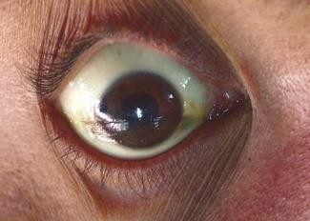
Tache Noir : At each side of iris , on sclera,
triangular in shape, yellowish brown in colour

Slide 11
→Lost (Absent)
→ A sign of death,
2. Corneal reflex
3. Flaccidity of eyeballs
→ Due to fall in intra ocular tension within minutes of death the eyeballs go flaccid.
but not a reliable one as even before death, in all cases of deep insensibility, it may be absent
→ IOT can be measured with TONOMETER
→ Normal value 15-25 mmHg Soon after death -12 mg After Half hour - 3 mg
After 2 hours - 0 ( zero )

Slide 12
4. Changes in Pupils :
→ Normal size is 2-5 mm,
< 2 mm – constricted, > 5 mm - dilated
→ Soon after death, due to relaxation of muscles of iris, pupils dilate and with onset of rigor mortis they come back to same position due to constriction- NOT A UNIVERSALLY ACCEPTABLE THEORY because in rigor mortis there is only stiffening and no shortening.
→ Till 1 hour ( molecular death ) it may dilate with
atropine but don’t react to strong light.

Slide 13
5. Retinal vessels: Show fragmentation or segmentation of
blood column in retinal vessels within few minutes and last for 1-2 hours.(Kevorkian sign)
Can be seen with Ophthalmoscope.
It is due to loss of blood pressure following loss of circulation.
6. Chemical changes: Post mortem chemical analysis of
vitreous humour show a steady rise on Potassium levels in decomposition pattern ( low Sodium and chloride and elevated Potassium) – Due to cell disintegration
Formula suggested by Madea & Henssge
PMI= 5.26 X K⁺ concentration( m.Eq./ L) – 30.9

Slide 14
III. PRIMARY FLACCIDITY OF MUSCLES
During this stage death is somatic
Lasts for 1-2 hrs
All muscles begin to relax
Body flattens over areas which are in contact with surface (contact flattening)

Slide 15
IV. COOLING OF BODY ( ALGOR MORTIS, CHILL OF DEATH):
Normal body temperature (Oral) : 36 – 37.2 ⁰C
Rectal temperature : 36.5 – 37.5 ⁰C ( for 3 min.)
Rectal temperature is 0.5 – 0.6 ⁰C higher than Oral
Make a small incision into the peritoneal cavity & inserting the thermometer in contact with the inferior surface of the liver
External auditory meatus – bulb of thermometer placed on or through tympanic membrane,
Nasal passages – bulb of thermometer passed up to the cribriform plate
Rectum – Ideal site to record temperature except in
case of Sodomy

Slide 16
Heat loss is by → CONDUCTION, CONVECTION,
EVAPORATION
Factors affecting heat loss :
Body weight and surface area- rapid in extremes of age
Proportion of fat- slow in obese persons and vice versa
→ fat - bad conductor of heat
Covering layers around body
Difference between body and ambient temperature- rate is more when the difference is more.
Environment → well ventilated place – faster cooling
→ closed room – slower cooling
→ moisture - rapid cooling, → dry atmosphere - slower
In India rate is 0.5 to 0.7 ⁰C per hour.

Slide 17
FORMULA:
Time in hours = Normal Body temperature – rectal temperature Rate of temperature fall per hour
For example,
Normal Body temperature is 37.2 ⁰C Rectal Temperature is 30.2 ⁰C ,
Rate of fall is 0.5°C per hour
TSD = 37.2 – 30.2 = 7 / 0.5 = 14 hours

Slide 18
V. POST MORTEM LIVIDITY: ( PM HYPOSTASIS, PM STAINING, LIVOR MORTIS, CADAVER LIVIDITY,
SUGGILATIONS, VIBICES, DARKENING OF DEATH )
Definition :
It is the bluish-purple or purplish-red discolouration which appears under the skin in the most superficial layers of dermis
( rete mucosum ) of the dependent parts of body due to capillo-venous distension after death.
Mechanism : Due to accumulation of blood in toneless distended blood vessels. It reflects the colour of Hb.

Slide 19
What means Dependant parts ?
POSITION DEPENDENT PARTS
1. Supine - Back of shoulders , chest, buttocks, thigh
2. Prone -
Face, front of chest & abdomen, thighs
Standing - Both hands, male genitals, soles
Kneeling - Both knee, front of legs, toes.

Slide 20
Time of Appearance & Disappearance :
Beginning - 30 minutes Confluence patches - 1- 4 hours
Fixation Disappearance
4 -12 hours( due to coagulation)
About 24 hours
Press the thumb on stained area,
→ If it fades and reappears on withdrawal – not fixed.
→ No change on pressure by thumb - fixed.

Slide 21
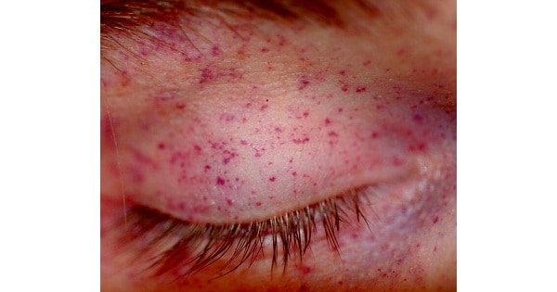
Vibices- are pale marks on a dead person skin that are caused by the dermal pressure. Ex- marks around neck from a rope.
Tardieu spot- These are small spots caused by the rupture of blood vessels under the influence of increased pressure from gravity.

Slide 22
Interpretation of colour of lividity :
Deep purple- in asphyxia due to
increase in amount of reduced Hb
Bright red- in cyanide poisoning due to cyan meth haemoglobin
Pink- in carbon monoxide poisoning due to carboxy Hb

Slide 23
Chocolate brown – in Potassium chlorate poisoning
due to meth haemoglobin.
Reddish brown – in Nitrite poisoning
Yellow or dark brown – in Phosphorous poisoning.
Pale or less prominent - anaemia, pneumonia

Slide 24
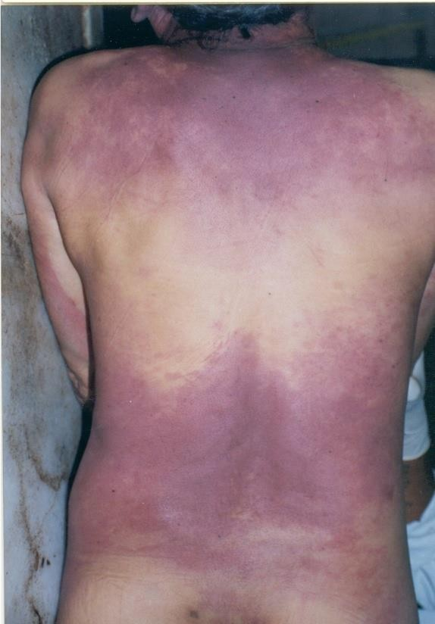

DARK RED COLOUR POST MORTEM LIVIDTY ON BACK OF CHEST
AND ABDOMEN ( DEPENDENT PARTS IN SUPINE POSITION)
Staining
Pale area due to contact flattening
Staining

Slide 25
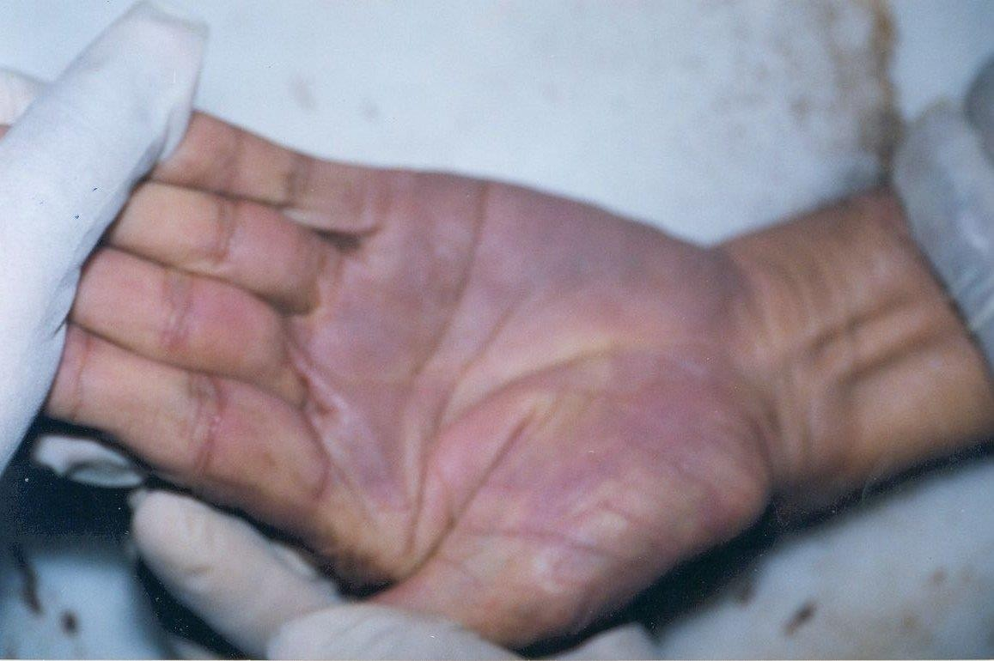
POST MORTEM LIVIDITY ON PALMAR ASPECT PF HAND IN CASE OF HANGING:

Slide 26
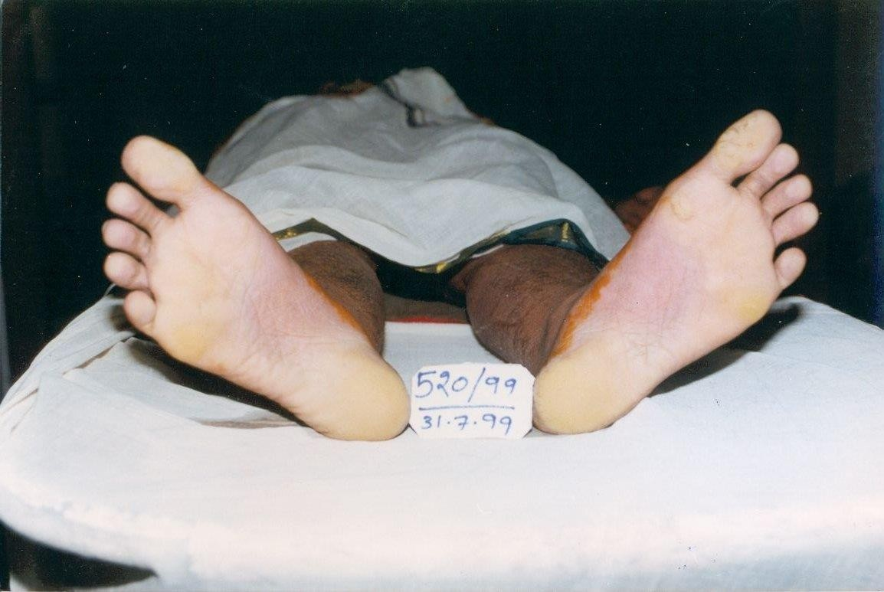
POST MORTEM LIVIDITY ON SOLES IN CASE OF HANGING:
Also note Yellow brown colour stains at edge -
MEHNDI

Slide 27

Medico Legal Importance of Post Mortem Lividity :
It is a reliable sign of death.
Indicates body position at death and any alteration in body position later on.
Peculiar colour may indicate particular poisoning ( cause of death ).
May indicate time since death – fixed or not.

Slide 28
6. CHANGES IN MUSCLES:
1. STAGE OF PRIMARY FLACIDITY:
- Generalised relaxation lasting up to 2-3 hours after death
-Reacts to external mechanical/ electrical stimuli due to
presence of molecular life
2. STAGE OF RIGOR MORTIS:
- Characterised by stiffness
3. STAGE OF SECONDARY FLACIDITY:
- With disappearance of rigor mortis , muscles again→ flaccid.

Slide 29
RIGOR MORTIS / CADEVERIC RIGIDITY
Definition :
It is a state of post mortem stiffening in both voluntary and involuntary muscles following the period of primary flaccidity
Mechanism : Each muscle comprises of myofibril – made up of proteins- Actin and myosin in interdigiting arrays.
→ ATP is required to maintain relaxation of muscle which is absorbed by muscle in state of relaxation and utilised for contraction.

Slide 30

→ After death, some amount of ATP is available till molecular death.
→ But after death as it is not available to maintain relaxation, the acto-myosin complex develops stiffness and produces muscular rigidity which disappears with autolysis of muscle fibres after some duration.

Slide 31
Sequence : Proximo - distal progression and disappearance in same sequence.
Nysten’s Rule : Both voluntary and involuntary muscles are affected.
→ It first appear in involuntary muscle : Myocardium( Heart)
→ First voluntary muscle: Eyelids
→ It begins in eyelids → Neck → lower jaw → muscles of face → muscles of chest → muscles of limbs → lastly fingers and toes.
→ It disappears in same sequence.

Slide 32
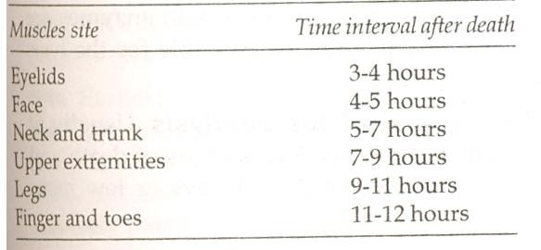

Slide 33
Time of Onset, Persistence and Disappearance of Rigor Mortis:
SEASON WINTER SUMMER AVERAGE
ONSET (hrs) Slow 2-6 Rapid 2-3 2-6 hrs
COMPLETION (hrs) | 6-24 | 3-18 | 6-12
PERSISTANT (hrs) | 24-48 | 18-36 | 12-24
DISAPEARENCE (hrs) | 48-72 | 36-48 | 24-36
RULE : When RM sets in early, it remains for shorter time duration and
disappears early.
When it sets in late, remains for longer time duration and
disappears slowly.

Slide 34
Factors affecting Onset, Duration & Disappearance of Rigor Mortis :
AGE: Extremes of age earlier & for shorter duration.
ENVIRONMENTAL TEMPERATURE:
Slow- in cold , rapid in hot environment
MUSCULAR STATE:
Rapid in thin body, slow in more muscular body.
CAUSE OF DEATH: EARLTY LATE
Cholera, typhoid, TB, cancer, nephritis Pneumonia, Asphyxia
CO, CO2, Arsenic

Slide 35
How Rigor Mortis is tested ?
By gently bending various joints
Perception
Free movement
Moves with little force
Moves with more force
NOT present in a part tested
Interpretation Not present
Present in moderate form
Present in strong form
Not appeared or
is appeared.
Developed & disappeared.
If distal parts show rigidity –
If proximal parts show rigidity – Not developed.

Slide 36
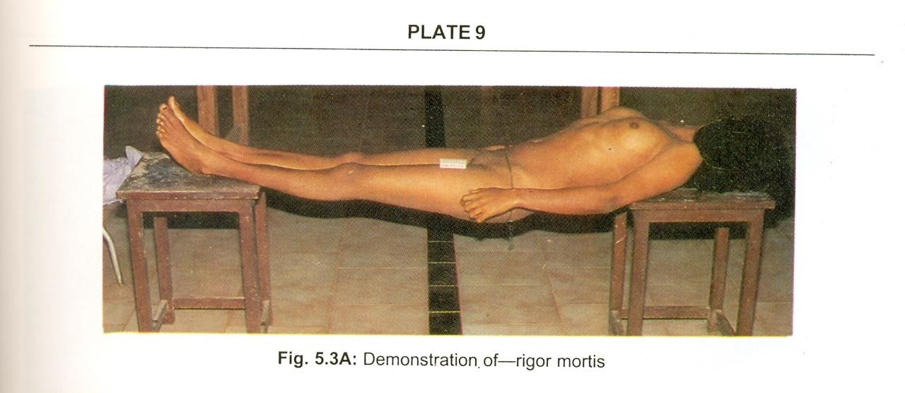
DEMONSTRATION OF RIGOR MORTIS

Slide 37

CADAVERIC SPASM:
Definition :
The group of muscles that were contracted just before death, become stiff and rigid without passing into stage of primary relaxation.
Mechanism : Obscure.
Probably, due to over activity just before death ATP gets exhausted and muscles pass into state of rigidity.
Circumstances : excitement, cerebral hemorrhage, Fear, injury to nervous system, cranial gunshots, convulsant poisons, efforts by a submerging victim.

Slide 38
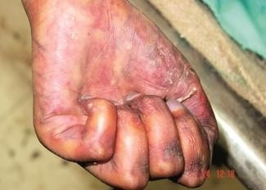
Cadeveric spasm
Grass firmly
held

Slide 39
Medico Legal Aspects :
Affects only a group of muscles.
Occasionally, in case of suicide. the weapon, e.g., pistol or knife is seen firmly grasped in the victim's hand which is a strong presumptive evidence of suicide. Attempts may be made to simulate this condition in order to conceal murder. But, ordinary rigor does not produce the same firm grip of a weapon, and the weapon may be placed in the hand in a way which could not have been used by a suicide.
If the deceased dies due to assault, some part of clothing, e.g., button of his assailant or some hair may be firmly grasped in the hands.
In case of drowning, material such as grass, weeds or leaves may be found firmly grasped in the hands, which indicates that the victim was alive on entering the water. .

Slide 40
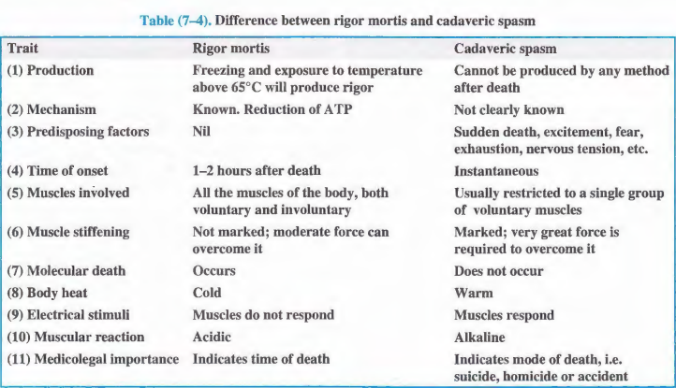

Slide 41
CHART showing major changes to estimate time since death
cooling
37°C
Rigor mortis
Temperature
decom
lividity
TSD-
0 6 12 18 24 30 3 6 42 48
54

Slide 42
LATE SIGN : PUTREFACTION
→ OUTSIDE the body – flies, maggots etc
INSIDE the body – anerobic bacteria- intestine
→Putrefaction is the decomposition of the body carried out by bacterial activity.
It involves the decomposition of the proteins, breakdown of the tissue and liquefaction of organs.
Mechanism- After death, anarobic bacteria migrate from the guts into blood vessels then into tissues, then then multiply and spread through the whole body.
→ Bacteria begins to multiply within 4 hours and reached at peak within 24-30 hours.
Note- The intestine contain more than 1 thousand different species of bacteria.

Slide 43
FACTORS FAVOURING BACTERIAL ACTIVITY:
Loss of protective mechanism
Open skin wounds
Fall in oxygen and rise in hydrogen
Fluidity of blood and carbohydrates & proteins in blood
Pre existing infection before death

Slide 44
ENZYMES AND THEIR ROLE IN PUTREFACTION:
Clostridium Welchii is the main destruction bacteria agent.
It produced Lecithinase and this bacteria hydrolysis the lecithin which is present in all cell membrane including blood cells is responsible for :
Postmortem haemolysis of blood
Disintegration of tissue
Gas formation
Other microbes: Streptococci, Staphylococci, B. Proteus, B. Coli
These multiply 10-100times even more in blood and tissue of corpses kept at room temperature.

Slide 45

CHARACTERISTIC FEATURES OF PUTREFACTION:
Changes in the colour of the tissues.
Evolution of Gases in tissues.
Liquefaction of tissues.
(The same changes seen on surface body occur simultaneously in internal organs.)
1. COLOUR CHANGES: In the early stage, due to diffusion of Hb
through the vessels the tissue shows red or brown colour.
→ In the tissues, Hb derivatives combine with Sulphur containing compounds forming sulphmeth haemoglobin and change
the colour into greenish black.
→ Caecum - the most superficial part of intestine so,
this change is perceived first there in about 12-18 hours in summer
and 1-2 days in winter.
This discolouration further spreads over entire abdomen, genitals, chest, neck, face arms and leg.

Slide 46
The clotted blood becomes fluid and which causes disappearance of post mortem lividity . Later this colour change spread all over the body.
2. EVOLUTION OF GASES:
→ Complex proteins and carbohydrate compounds disintegrate and produce gases like:
AMONIA, CARBON MONOXIDE, CARBON DIOXIDE, HYDROGEN
SULPHIDE, PHOSPHORATED HYDROGEN, METHANE, MERCAPTANS.
→ Collection of these gases in loops of intestine leads to distension of
abdomen , So, on opening the abdominal cavity these gases come out with force and hissing sound.

Slide 47
This gases entrapped in closed area goes on accumulating and lead to :
Protrusion of eye balls
Swollen appearance of face
Protrusion of tongue out of oral cavity
Oozing out of fluids from orifices like nose mouth, ear, anus and vagina
Post mortem blisters due to separation of layers of
epidermis
Expulsion of foetus in pregnant woman
Protrusion of rectum through anus

Slide 48
Loosening of hair, teeth and nails.
Protrusion of cavity contents from open wounds.
Peeling of cuticle leading to DEGLOVING & DESTOCKING of Skin of hands and feet respectively
→ Post mortem luminescence ( shining look) is due to light
producing organisms like:
PHOTOBACTERIUM FISCHERI, ARMILARIA MALLEA( fungi)
→ Bodies submerged under water surface due to gases.

Slide 49
FACTORS AFFECTING RATE OF PUTREFACTION:
Temperature : Faster in high temp, arrested below 0⁰c & above 48⁰c
Moisture : Organs which contain water decompose more readily than the dry one.
Air : Free access hastens putrefaction
Clothings and coverings : Tight clothes like belts, suspenders,
socks, undergarments & boots slows putrefaction
Age : Children – rapidly, Old people - slowly
Built : Fat bodies – more rapid than lean
Cause of death- Putrefaction is delayed after death due to wasting diseases, anaemia, severe haemorrhage, debility, poisoning by carbolic acid, zinc chloride, strychnine and chronic heavy metal poisoning, due to the preservative action
Degree of mutilation : Higher mutilation – more rapid putrefaction
CASPER’S DICTUM: Rate of putrefaction:states that a body decomposes in air twice as rapidly as in water, and eight times as rapidly as in earth.
Above earth Under water Under earth
8 2 1

Slide 50
Marbling of the skin:
→ The superficial veins especially over the roots of the limb, thighs, sides of the abdomen, shoulders, chest and neck are stained greenish-brown or purplish-red depending on the total amount of sulphhaemoglobin formation within the affected vessels (linear branching pattern) due to the haemolysis of red cells, which stains the wall of the vessel and infiltrates into the tissue, giving a marbled appearance (red, then greenish pattern in skin resembling the branches of a tree).

Slide 51
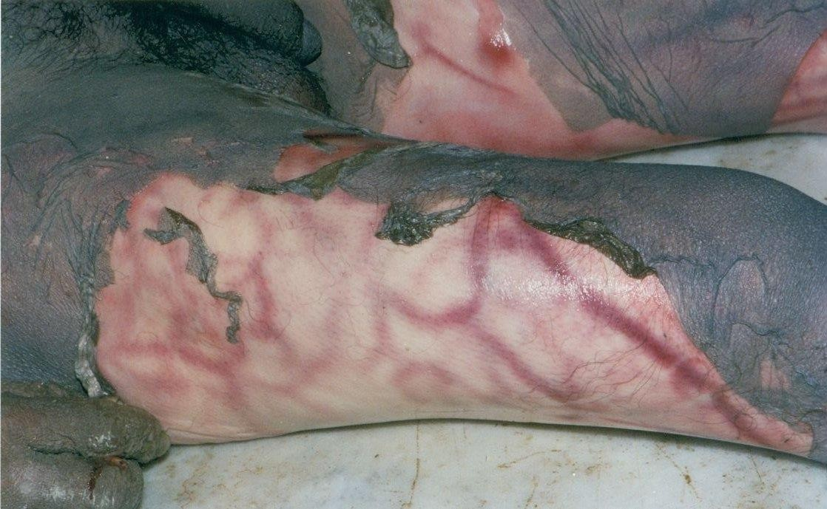
MARBLING EFFECT- Prominent toneless superficial veins filled with hemolysing blood against pale dermis.

Slide 52
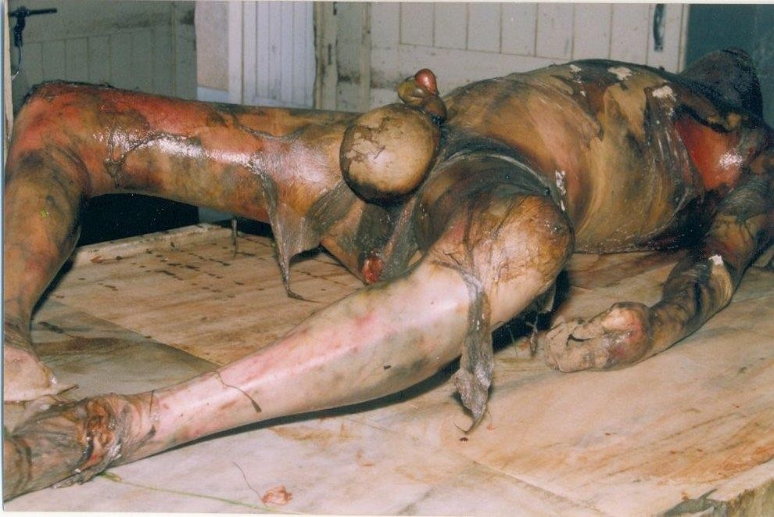
A DECOMPOSING DEAD BODY- Swollen appearance, peeling of
epidermis,brown discolouration and blisters.

Slide 53
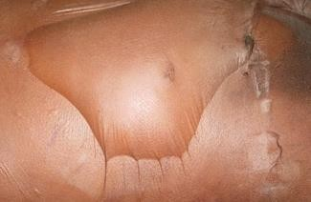
Blister of decomposition( post mortem)
Contains air and thin
clear fluid Base is pale

Slide 54
SEQUENCE OF PUTREFACTION IN ORGANS
1. Larynx and trachea
2. Stomach, intestine and spleen
DEPENDS ON TISSUE
3. Liver and lungs
COMPOSITION- BLOOD,
4. Brain
FIBROUS , CARTILAGENOUS
4. Heart
FLUID RICHNESS
5. Kidney, bladder
6. Prostate , uterus
7. Skin, muscles and bones.

Slide 55
3.LIQUEFACTION- Colliquative putrefaction starts in 5-10 days and all soft tissue start loosing their normal architecture. The concerned cavity gets filled with liquefied tissue materials.
The abdomen bursts and the stomach and intestines protrude.
In children, thorax also bursts.
Blood slowly disappears from blood vessels.
In obese people, the body fats, may liquefy into a translucent, yellow fluid filling the body cavities between the organs.
The tissues become soft, loose and are converted into a thick, semi-fluid, black mass and are separated from the bones and fall off.

Slide 56

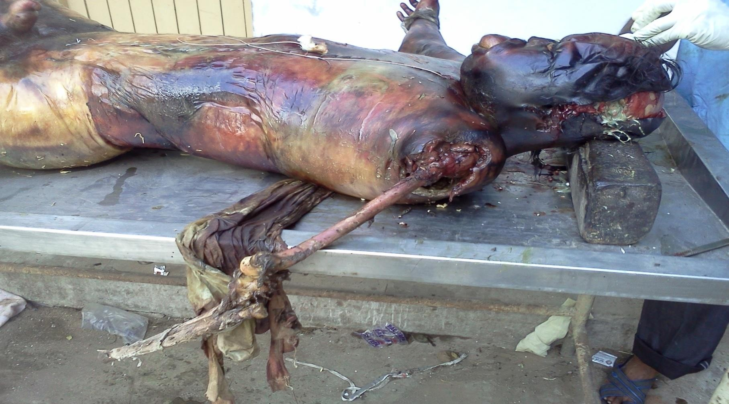

Slide 57

Adipocere ( Saponification ) :
Adipocere (cire=wax) is a modification of putrefaction. In this, the fatty tissues of the body change into a substance known as adipocere.
It is seen most commonly in bodies immersed in water or in damp, warm environment.
Mechanism:
The change is due to the gradual hydrolysis and hydrogenation of pre-existing fats, such as olein, into higher fatty acids, which combine with calcium and ammonium ions to form insoluble soaps, which being acidic, inhibit putrefactive bacteria.
Ultimately, the whole of the fat is converted into palmitic, oleic, stearic and hydroxystearic acid, together with some glycerol, and a mixture of these substances forms adipocere.

Slide 58
Bacterial action : Cl. Perfringens produces Lecithinase which leads to
hydrolysis and hydrogenation.
Water is essential for the bactetial and enzymatic processes involved in adipocere formation.
Properties :
→ Strong amonical smell in early stage followed by sweetish
offensive smell.
→ Fresh adipocere is soft, moist, whitish and translucent.
→ Old adipocere is dry , hard, cracked yellowish in colour and
brittle
→ It floats in water but dissolves in ether and alcohol.
→ It is inflammable and burns with yellow flame.

Slide 59
Time required for Adipocere formation:
-- 3-4 weeks in summer in temperate countries
-- In India, it has been observed to begin within 4 to 5 days. Adipocere may persist for years or decades.
Distribution :
→ The face, buttocks, breasts and abdomen are the usual sites. The limbs, chest wall, or other parts of the body may be affected, but sometimes the entire body is converted into adipocere. Fatty tissue between the fibres of skeletal muscle and in the myocardium and in the substance of the liver. kidney. etc .. is also converted into adipocere. T.
Medico legal application :
Help in establishing identity as features are preserved.
May help in ascertaining cause of death from wounds.
Gives idea about time since death.

Slide 60
Mummification :
It is a modification of process of putrefaction in which
shrivelling and drying of dehydration of water.
Factors necessary :
1. Absence of moisture in the air
dead body occurs due to
2. Persistent action of dry air
Appearance :
→ Shrunken skin, dry, leathery, fragile and rusty brown in colour
→ Skin adheres tightly to bony prominences
→ It begins in the exposed parts of the body like face, hands and feet and then extends to the entire body including the internal organs.

Slide 61
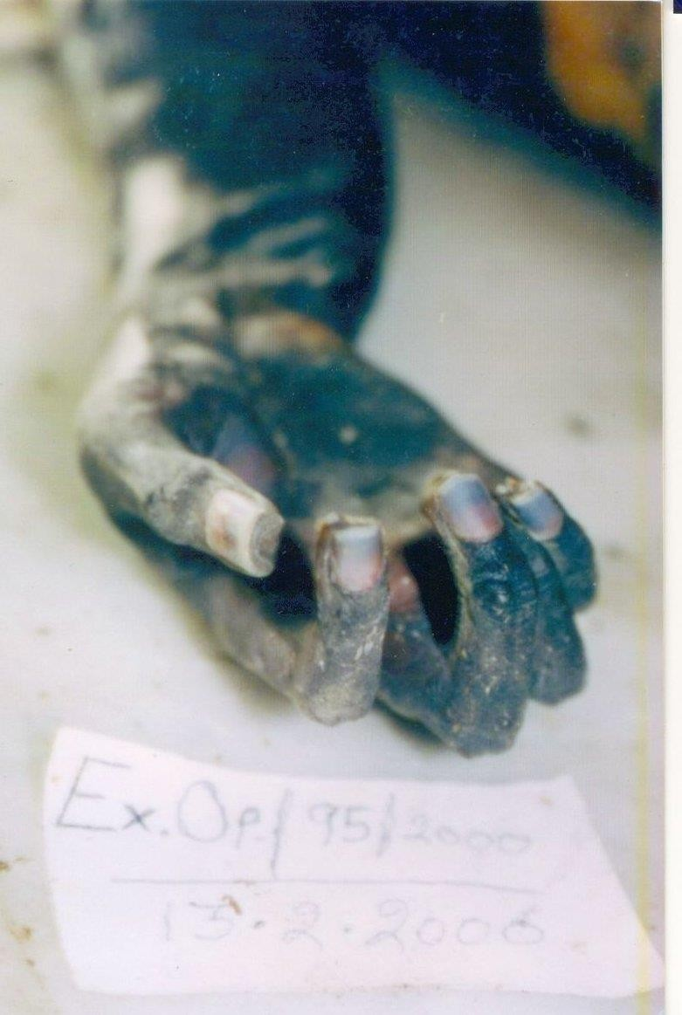
MUMMIFICATION
BLACK DISCOLOURATION,
SHRUNKEN SKIN.
NAILS show pink nail polish in lower half and blueness in upper half.

Slide 62
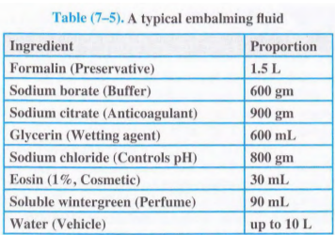
EMBALMING- Preserving of the dead body.
Emblaming is the treatment of the dead body with antiseptics and preservatives to prevent putrefaction and preserve the body.

